Slide 1

Personal Finance Management
Personal Finance Management

Slide 2
The Millionaire’s Secret
Living within your means
-OR-
Only buying what you can afford

Slide 3
Look at these scenarios
Aarav, 23—earns a monthly salary of Rs.10,000 from his call centre job. His average monthly spending on livelihood and looking good is about Rs.9200. He currently has no investments and has an amount of Rs.3200 overdue on his credit card.
Babu, 30—earns Rs.4,000 per month as a bank clerk. He spends a maximum of Rs.2000 in a month. He has Rs.4800 in his savings account but has not made any significant investments yet. He has to pay an EMI of Rs.800 towards home loan.
Chanda, 26—is a housewife who gets Rs.4500 from her husband every month towards household expenses. She makes it a point to put Rs.500 in her savings account as soon as she gets her ‘allowance’. She has managed to build a reserve of Rs.3000 so far.
David, 19—a third year commerce student has built an investment portfolio of Rs.5000 in mutual funds. He started investing a part of his allowance, cash prize and gifts on his 19th birthday, 6 months back.
Is INCOME the indicator of one’s financial position?
Notes:
If income were the only indicator of your financial situation, then Aarav’s situation can be considered the strongest. But does he seem to be doing well with his money? Is his financial position really strong? Can he take care of any financial emergency like a job loss or drop in income?
In fact, looking at the overall picture, Aarav even with his fat paycheck, is in the worst financial situation at present. His expenses are almost as much as his income. And his credit card debt has got him into a financial mess. Considering his meager monthly ‘balance’ and high interest rate on credit card debt, Asif would need more than 6 months to payback the debt, if nothing else changes.
The other three, despite their lesser incomes/allowance, seem to be doing decently in their own way—building saving reserves and assets. Whereas Babu has a decent saving and asset-building home loan, Chanda has her own savings account.

Slide 4
To sum up, income alone is no indicator of your financial position. The four cornerstones of your financial foundation are:
1. Income in relation with your
2. Expenses,
3. Assets and
4. Liabilities
And hence, no matter how much or little you are earning currently, how you manage the four cornerstones would decide how strong and stable your financial foundation will be.

Slide 5
So how do you get the 4 cornerstones of your financial foundation in place? Use the tripod of money management—Record Keeping, Budgeting and Saving
Record keeping — timely recording of expenses and meticulous keeping of important documents and records; bills, receipts, tax documents, statement of savings, investments and credit cards, warranty/guarantee cards.
Budgeting — making and following a plan to put your money to optimum use. A plan that would enable you to-
- reduce liabilities, - to spend wisely, - to save, and
- invest and add to your income.
Saving — building reserves to be able to-
- face financial emergencies, and
- invest and build assets.
Your financial position is a mix of all these things. Just earning a lot of money (income) isn’t enough if you’re spending too much (expenses), have lots of debt (liabilities), or don’t own anything valuable (assets). To have a strong financial foundation, you need to manage your income, keep expenses in check, grow assets, and minimize liabilities.

Slide 6
The Money Management Process

Slide 7
Remember Budgeting?
Budgeting IS…
Budgeting is NOT…
A money management system
Setting financial goals
Saving money
Preparing for the future
A money management system
Setting financial goals
Saving money
Preparing for the future

Slide 8
The power of money multiplies when its use is maximized. Money is not just to spend on present needs and wants nor is it to simply save.
With your money, you should be able to:
meet your needs and monthly household expenses,
build a healthy saving to meet your future goals,
build a financial safety net to stabilize your financial present and future deal with emergencies without a significant financial impact, and
set aside money to grow through investments

Slide 9
How do you find money for everything?
Trim the extras
Almost every household would have spending areas that can be cut or reduced. These areas often eat into probable savings. It would be easy to identify these trim-able spending areas, if you classify your expenses in 3 main groups;
Needs or essentials - bills you must pay to run your household and to keep your family healthy and comfortable. Utilities (electricity, gas, water), housing-rent/home loan installments, groceries, health, transport, insurance, education, are your needs. Things that make your life simpler and more convenient can also be regarded as needs.
Wants - all other ‘nice to have’ expenses for entertainment, travel/holidays, gifts, looking good, fun and celebrations, etc
Wastes - excessive tea/coffee, cigarettes, alcohol, gambling, spending on wants beyond your means. Wastes eat a major chunk of your money bit by bit at a time.
Spending Mantra - spend on needs first, wants later and waste never!

Slide 10
Key Points
Smart money management can benefit everyone.
Save first, save now and save regularly.
Spend on needs first, wants later and waste never.
Money just flies and you lose the count, as a good practice you must keep an account.
Spend, save, invest and share — allocate your money with wisdom and care.

Slide 12
Personal Finance Management
Objectives:
1. To create awareness and educate consumers on access to financial services.
2. To make the students understand the basic concepts, definitions and terms related to direct taxation.
3. To help the students compute the Goods and Service Tax (GST) payable by a supplier after considering the eligible input tax credit.
4. To familarise the students with microfinance for accelerating the expansion of local microbusinesses.

Slide 13
Outcomes: On completion of the course, learner will be able to:
Understand the Indian financial system
Use a framework for financial planning to understand the overall role finances play in his/her personal life.
Compute income from salaries, house property, business/profession, capital gains and income from other sources.
Compute the amount of CGST, SGST and IGST payable after considering the eligible input tax credit.
Understand how Microfinance can help in financial inclusion.

Slide 14
Module 1
Overview of Indian Financial System:
Characteristics, Components and Functions of Financial System. Financial Instruments and Financial Markets, Financial inclusion.
Introduction to Personal Finance
Person Financial Planning in Action, Money Management Skills, Taxes in Your Financial Plan, Savings and Payment Services. Consumer Credit: Advantages, Disadvantages, Sources and Costs

Slide 15
Module 2
Personal Financial Management
Loans: Home, Car, Education, Personal, Loan against property and Jewel loan.
Insurance: Types of Insurance – ULIP and Term; Health and Disability Income
Insurance, Life Insurance.
Investment: Investing Basics and Evaluating Bonds, Investing in Stocks and Investing in Mutual Funds, Planning for the Future.

Slide 16
Module 3
Income Tax
Income Tax Act Basics- Introduction to Income Tax Act, 1961
Heads of Income and Computation of Total Income and Tax Liability- Heads of Income and Computation of Total Income under various heads, Clubbing Provisions, Set off and Carry forward of Losses, Deductions, Assessment of Income and tax liability of different persons.
Tax Management, Administrative Procedures and ICDS - TDS, TCS and Advance Tax Administrative Procedures, ICDS.

Slide 17
Module 4
Goods and Services Tax
GST Constitutional framework of Indirect Taxes before GST (Taxation Powers of Union & State Government); Concept of VAT: Meaning, Variants and Methods; Major Defects in the structure of Indirect Taxes prior to GST; Rationale for GST; Structure of GST (SGST, CGST, UTGST & IGST); GST Council, GST Network, State Compensation Mechanism, Registration.
Levy and Collection of GST
Taxable event- "Supply" of Goods and Services; Place of Supply: Within state, Interstate, Import and Export; Time of supply: Valuation for GST- Valuation rules, taxability of reimbursement of expenses; Exemption from GST: Small supplies and Composition Scheme: Classification of Goods and Services

Slide 18
Module 5
Introduction to Micro – finance
Micro-Finance: Definitions, Scope & Assumptions, Types of Microfinance, Customers of Micro-finance, Credit Delivery Methodologies, SHG concept, origin, Formation & Operation of Self Help Groups (SHGs).
Models in Microfinance - Joint Liability Groups (JLG), SHG Bank Linkage Model and GRAMEEN Model: Achievements & Challenges,
Institutional Mechanism
Current Challenges for Microfinance, Microfinance Institutions (MFIs): Constraints & Governance Issues, Institutional Structure of Microfinance in India :NGO-MFIs, NBFC-MFIs, Co-operatives, Banks, Microfinance Networks and Associations; Demand & Supply of Microfinance Services in India, Impact assessment and social assessments of MFIs,

Slide 19
Evaluation Scheme:
Semester End Examination (A):
Theory:
Question paper based on the entire syllabus will comprise of 4 questions (All compulsory, but with internal choice as appropriate), each carrying 15 marks, total summing up to 60 marks.
Total duration allotted for writing the paper is 2 hrs.
Continuous Assessment (B):
Theory:
TT1 -15 marks
TT2 - 15 marks
TT3 -10 marks (Quiz/assignment/presentation)

Slide 20
“Why do I need to learn about finance.. I am very good in my own area of specialization”
How would you react to the above statement?

Slide 21
Financial System
The financial system is essential for a country’s economic growth, as it provides the structure and tools needed to support development.
Finance assists in reducing the gap between the present and the future, and covers every aspect like channelization and effective usage of savings and making an efficient investment.
It formulates the base, the sets and the tone for the accomplishment of wider national objectives.

Slide 22
A financial system acts as an intermediary where there is surplus and deficiency of funds. It bridges the gap between the two segments
It comprises of various institutions, markets, regulations, laws, money managers, experts and many others.
In short, financial system is a mechanism
by which savings are transformed into investments.

Slide 23
Indian Financial System
Network of closely connected institutions, agents, markets, instruments and services that facilitate the flow of funds within the economy.
Channelize financial resources from surplus units (savers) to deficit units (borrowers), enabling economic activities to function smoothly.
Provide a link between savings and investment for the creation of new wealth, permit portfolio adjustment in the composition of the existing wealth

Slide 24
Characteristics of Financial system
Financial system establishes a link between the one having surplus funds with those who are in need of such funds. Both the investment and the savings aspects are encouraged.
Financial system contributes towards the expansion and the development of financial markets.
Financial system facilitates the efficient allocation of financial resources for the benefit of the society and the public at large.
Financial system enhances the economic quality and accelerates economic development hence lays the foundation for an ideal economy.
It provides a mechanism for the transfer of resource across geographical boundaries.
The financial system helps fund seekers to build an efficient portfolio.
Financial system reduces the transaction costs.
Financial system ensures the availability of all the price-related information.

Slide 25
Functions of Financial System
To connect the investors with the Savers
Ensure liquidity
Assistance in selection of a project to invest in
Mobilization of Savings and facilitates investment
Managing uncertainty and controlling risk
Availability of Information
Reducing the Cases of Asymmetric Information
Reduction in the Borrowing and the Transaction Cost
Payment and Settlement

Slide 26
Components of Financial System
Financial Institutions
Financial Markets
Financial Instruments/ Securities/Assets
Financial Services

Slide 27
Financial Institutions

Slide 28
Financial Institutions
A financial institution (FI) is an organization that facilitates the flow of capital between savers and borrowers.
Act as an intermediary and facilitator in financial transactions at the individual and the corporate level.
They are the ones who channelize the savings and allocate the funds in the most optimum manner.
It offers a wide range of financial products and services that enable individuals, businesses and governments to manage their money, invest for the future and access the capital they need to grow.

Slide 29
Classification of Financial Institutions
Classified in three different categories :
Regulatory Institutions
Banking Institutions
Non-banking Institutions

Slide 30
Regulatory Institutions
Regulatory institutions are government or statutory bodies that monitor, supervise and regulate financial markets, institutions, and services to ensure transparency, stability, investor protection and economic integrity
It comprises of RBI, SEBI, IRDAI, etc.
Primarily, an investor would want the funds to be under the control and to be safe to invest. This assurance is rendered by the regulatory authority that is regulating the particular market.
For example, money market instruments are regulated by the RBI whereas the capital market instruments are regulated by SEBI.

Slide 31
Functions of Regulatory Institutions
Formulate Policies: Define rules and regulations for financial operations.
Supervision and Inspection: Monitor compliance and take corrective action.
Licensing: Grant permission to operate banks, insurance firms, mutual funds, etc.
Protect Consumers: Prevent fraud, ensure fair practices, and resolve complaints.
Maintain Stability: Prevent financial crises and maintain trust in the system.
Promote Growth: Encourage healthy competition and innovation in the financial sector.

Slide 32
Regulatory Institutions
TIM | Full Form | Area of Regulation | Key Role
RBI | Reserve Bank of India | Banking and NBFCs | Regulates banks, issues currency, controls inflation, manages foreign exchange
SEBI | Securities and Exchange Board of India | Capital Markets (Stock, Mutual Funds, etc.) | Regulates stock exchanges, protects investors, monitors market manipulation
IRDAI | Insurance Regulatory and Development Authority of India | Insurance Sector | Regulates life and general insurance companies, ensures fair practices
PFRDA | Pension Fund Regulatory and Development Authority | Pension Funds | Oversees NPS (National Pension System), ensures retirement security
NABARD | National Bank for Agriculture and Rural Development | Rural and Agricultural Finance | Regulates cooperative and regional rural banks; promotes rural development
SIDBI | Small Industries Development Bank of India | MSMEs Financing | Regulates and supports funding to Micro, Small, and Medium Enterprises (MSMEs)
FMC (merged with SEBI) | Forward Markets Commission | (Earlier) Commodities Market | Now part of SEBI for regulating commodity derivatives market

Slide 33
Banking institutions are financial organizations, also called as depository institutions that accept deposits from the public, provide loans, and offer various financial services to individuals, businesses, and the government.
Banking Institutions
Primary functions
a) Accepting Deposits: Banks collect money from individuals and businesses in the form of:
Savings Deposits – for individuals with lower interest
Current Deposits – for businesses with no interest
Fixed Deposits – for a fixed term with higher interest
Recurring Deposits – monthly deposits with interest
b) Providing Loans and Advances: Banks lend money to individuals, businesses, and governments through:
Term Loans – personal, home, vehicle loans
Cash Credit/Overdraft – for businesses
Trade Credit/Working Capital Loans
Secondary Functions
a) Agency Functions: Banks act on behalf of customers to:
Pay bills, rent and insurance premiums
Collect dividends, pensions, interest, etc.
b) General Utility Services
Provide safe deposit lockers for valuables
Issue demand drafts, cheques, and banker's cheques
Offer foreign exchange services
Issue credit/debit cards
Provide mobile and internet banking

Slide 34
The two types of banking intermediaries are as follows :
Commercial Banks :
Provide banking services to the general public and businesses
Accept savings, current, and fixed deposits
Offer loans and advances, credit cards, lockers, etc.
Examples: Public Sector: SBI, PNB, Bank of Baroda
Private Sector: HDFC Bank, ICICI Bank, Axis Bank
ii) Cooperative Banks:
Operate on the principle of cooperation and mutual help
Provide services to rural, agricultural, and small-scale sectors
Owned and managed by members/customers
Examples: District Central Cooperative Banks (DCCBs), State Cooperative Banks
How They Use Their Income: Cover operational costs (staff salaries, branch maintenance), Create reserves (as required by law), Reinvest in development and technology, Provide dividends to members (if surplus exists), Fulfill social or developmental goals.
Cooperative banks focus more on serving their members and promoting financial inclusion, but they still follow standard banking models to earn income — mainly through interest on lending.

Slide 35
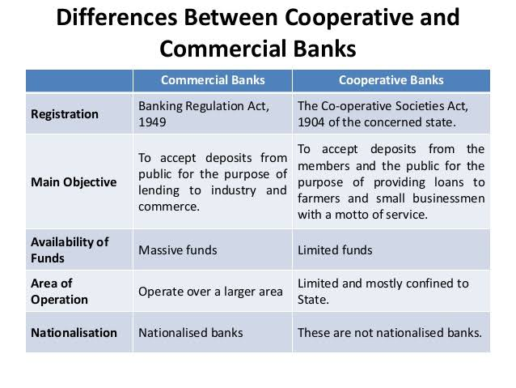

Slide 36
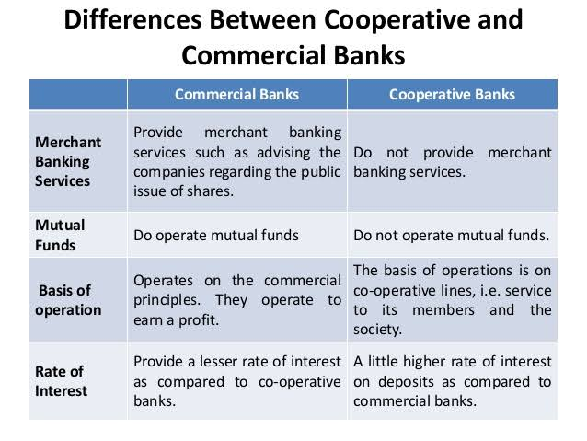

Slide 37
Functions of Commercial bank
Commercial banks provide retail banking services to household and business customers
They are licensed deposit-takers – providing a range of savings accounts
They are licensed to lend money (and thereby “create” money e.g. in the form of bank loans and overdrafts
Commercial banks are profit-seeking
A commercial bank’s business model relies on receiving a higher interest rate on the loans (or other assets) than the rate it pays out on its deposits (or other liabilities)
This “spread” on their assets and liabilities is used to pay the operating expenses of a bank and also to make a profit.

Slide 38
Non-Banking Institutions
The non-banking, also called as Non- Depository Institution includes following institutions :
1) Non-Banking Financing Institutions (NBFI)/ Non-Banking Financing Companies (NBFC)/ :
An NBFC is a financial institution that provides banking-like services such as loans, and asset financing, but does not hold a banking license.
Financial institutions who do not accept any deposit.
Financial institutions who do not accept demand deposits (except few NBFC’s).

Slide 39
Non-Banking Institutions
2) Investment Companies (Mutual funds):
They may be called a trust or a corporation which collects pool of money from many investors.
The money is managed by a professional fund manager, who invests that money in various assets like stocks, bonds, gold, or other securities.
The individual need not invest in single company shares but can rather purchase units directly from the investing company which are well diversified. For example, UTI and Mutual Fund.

Slide 40
Non-Banking Institutions
3) Insurance Companies :
It is a financial institution that provides protection against financial loss.
It collects premiums from people or businesses and, in return, promises to compensate them for specific types of losses (such as accidents, death, fire, or theft) based on the insurance policy.
Note:
Insurance is not an investment for returns, but a risk management tool
The policyholder must understand terms and conditions before buying

Slide 41
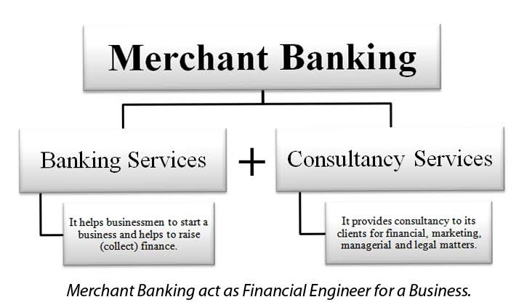

Slide 42
Merchant Banks
A merchant banker usually refers to a firm or organization involved in all aspects of issue management. Their services include providing consultancy or advisory services to corporates for issue management, making arrangements for buying, selling or subscribing to shares in an issue or any other consultancy or services such as underwriting, analysis and advice related to mergers and acquisitions, arranging offshore funding or venture capital, credit syndication and portfolio management.

Slide 43
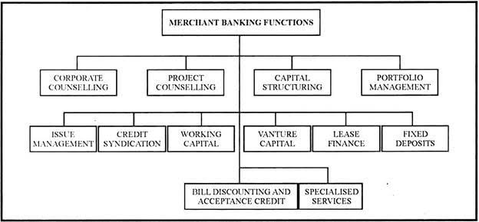
Functions of Merchant Banks

Slide 44
Leading merchant bankers in India
Public sector: SBI Capital Markets, Punjab National bank, IFCI Financial Services
Private sector: ICICI Securities, Axis Bank, Bajaj Capital, Tata Capital Markets, Yes Bank, Kotak Mahindra Capital Company, Reliance Securities
Foreign merchant bankers: Goldman Sachs (India) Securities, Morgan Stanley India, Barclays Securities (India), Bank of America, Citigroup Global Markets India
Notes:
IFCI= Industrial Finance Corporation of India

Slide 45
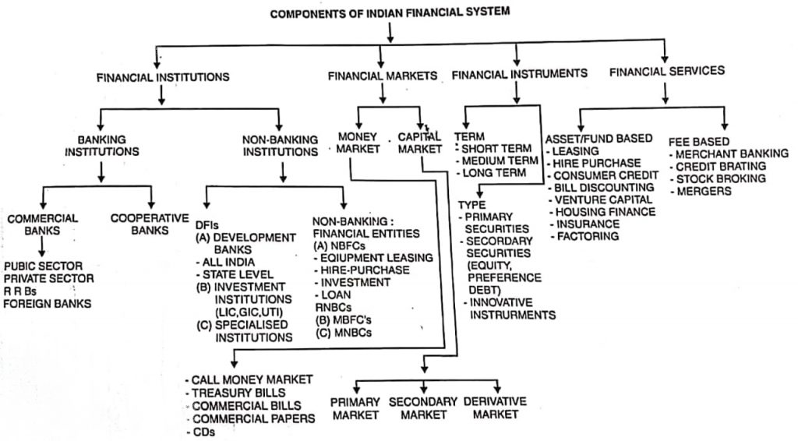

Slide 46
Financial Markets

Slide 47
Financial Markets
There does not exist a physical or geographical location that can be termed as a financial market but all the financial transactions are deemed to occur in the financial market. So, it can be said that as financial transactions are pervasive in nature, financial markets are also pervasive.
A financial market is a common place where the buyers and the sellers of financial instruments meet and exchange products. Stock exchange may be termed as a place where these transactions take place and a location for the financial market.
In India, financial markets are classified as unorganized and organised markets.

Slide 48

STRUCTURE OF MONEY MARKETS
ORGANISED MONEY STRUCTURE
UNORGANISED MONEY STRUCTURE

Slide 49
ORGANISED MONEY STRUCTURE
PARTICIPANTS:
Reserve bank of India.
DFHI (discount and finance house of India)
Commercial banks:-
Public sector banks
SBI with 7 subsidiaries Cooperative banks
12 nationalized banks
Private banks
Indian Banks Foreign banks
Development bank
IDBI, IFCI, ICICI, NABARD, LIC, GIC, UTI etc.

Slide 50

UNORGANISED SECTOR
Indigenous
Money lenders
Unregulated Intermediaries
aries

Slide 51
INDIGENEOUS BANKS
Private firms that receive deposits and give loans and thereby operate as banks
As activities are not regulated properly ,they are unorganized segment
Broadly classified into 4 groups- GUJARATI SHROFFS, MULTANI SHROFFS, CHETTIARS AND MARWARI KAYAS

Slide 52
MONEY LENDERS
Broadly classified into 3 categories:
PROFESSIONAL MONEY LENDERS
ITINERANT MONEY LENDERS
NON PROFESSIONAL MONEY LENDERS

Slide 53
UNREGULATED INTERMEDIARIES
FINANCE COMPANIES- gives loans to the retailers, artisans and other self-employed persons
CHIT FUNDS- are saving institutions
NIDHIS- operate in unregulated credit market and provide kind of mutual benefit funds
Notes:
Nidhi company is a financial institution that operates on the principle of mutual benefit, providing financial services exclusively to its members, who are also its shareholders. Nidhis cannot lend money to the general public; they can only transact with their own members. Nidhi companies are registered under the Companies Act of 2013 and are governed by the Ministry of Corporate Affairs.
Minimum Membership: They require a minimum of 200 members.
Capital Requirements: A Nidhi company needs a minimum paid-up equity share capital of ₹5 lakhs and a net-owned fund of at least ₹10 lakhs.
No Public Issuance of Shares: Nidhi companies cannot raise capital by issuing shares to the public.

Slide 54

KINDS OF FINANCIAL MARKET
Financial market is classified in two types of market

Slide 55
MONEY MARKET
It means a ready market or a short-term market where securities are bought or sold only for a very short duration.
The tenure usually does not exceed one year thus is considered to be an equivalent to cash only.
The securities are highly liquid in nature and can be readily converted to the cash.
The transaction cost is also the minimum.

Slide 56
DISADVANTAGES OF MONEY MARKET
Absence of integration
Shortage of funds
Lower rate of return
Larger amount of transaction fee

Slide 57
CAPITAL MARKET
It is a market where securities are usually held for long-term basis, i.e., more than one year. They do not have a fixed maturity or expiry date. The buyer can hold the same, till the time he wishes to do so.
1) Equity Market :
It comprises of the equity shares of the company. Equity shares are further classified in two categories :
i) Primary Market :
Where the shares are. being sold for the very first time, i.e., Initial Public Offer (IPO) and Right Issues.
ii) Secondary Market :
Where the existing shares are bought or sold, after they were originally issued to the public. These shares are listed on stock exchange through which they can be traded.

Slide 58
2) Debt Market :
It is the financial market in which debt securities are bought and sold by the investors.
These securities are in the nature of bonds or debentures and carry a fixed rate of return.
They are fixed income bearing securities that are issued by the Central and State Governments municipal corporations, other government bodies, and commercial entities like financial institutions, banks, PSU, public limited companies, etc.

Slide 59
Financial Instruments/ Securities/Assets

Slide 60
3 Types of Financial Instruments
Money market instruments.
Capital market instruments.
Hybrid instruments.

Slide 61
On the basis of term the financial instruments can be classified into following three types:
Short-Term
Long-Term
Medium-Term
1) Short-Term Financial Instruments:
The short-term financial instruments include the instruments which are of less than one year. The various types of securities are T-bills and commercial paper. The different kinds of cash can be deposits, certificate of deposits, etc. which are as follows :

Slide 62
Money market instruments
Call/Notice Money
Treasury Bills
Term Money
Certificate of Deposit
Commercial Papers

Slide 63
COMPOSITION OF MONEY MARKET
Call /Notice-Money Market
Call/Notice money is the money borrowed or lent on demand for a very short period. When money is borrowed or lent for a day, it is known as Call (Overnight) Money.
Intervening holidays and/or Sunday are excluded for this purpose. Thus money, borrowed on a day and repaid on the next working day, (irrespective of the number of intervening holidays) is "Call Money".
When money is borrowed or lent for more than a day and up to 14 days, it is "Notice Money". No collateral security is required to cover these transactions.

Slide 64
Treasury Bills:
Treasury bills show the responsibilities of Government of India.
It is basically of 91 days, 182 days and 364 days. They are given to the customers on the auction basis every week which has certain small denominations which are issued by the Reserve Bank of India.
It does not have any specific interest rate so they are sold on discount and are redeemed at face value.

Slide 65
Inter-Bank Term Money
The interbank money market is a market in which banks extend loans to one another for a specified term at interbank rates
Inter-bank market for deposits of maturity beyond 14 days is referred to as the term money market.
The entry restrictions are the same as those for Call/Notice Money except that, as per existing regulations, the specified entities are not allowed to lend beyond 14 days.

Slide 66
Certificates of Deposit (CD):
CD is also a money market instrument issued by banks to the depositors, in the form of certificate showing the existence of such deposit with them.
These certificates are in turn traded by the depositors (when such a need arises) between their business associates.
In short, under this arrangement, the Bank deposit may be transferred from one owner to another, any number of times, before its maturity.
Interest on such deposits continues to be paid in the normal course.
The price of CD depends on the (a) Rate of interest available on the Bank Deposit (which is fixed), and (b) Rate of interest prevailing in the market at that particular time.

Slide 67
Commercial Paper (CP):
A commercial paper is an unsecured promissory note and money market instrument, issued by large corporate houses for raising funds with a view to meeting their short-term debt obligations such as payroll.
CP is not secured by collateral security. It is supported by an issuing bank or company who promise to pay the face value at the maturity date indicated on the note,
As it is an unsecured instrument, only the organizations with exceptional credit ratings are capable of issuing their commercial paper at an economical price.
The maturity period of Commercial Paper ranges between 15 days and one year. On maturity date, the issuer has to repay the due amount without any delay. There is no provision of grace period in this case.

Slide 68

Merits of Commercial Paper
Technically, it provides more funds compared to other sources. The cost of commercial paper to the issuing firm is lower than the cost of commercial bank loans.
It is in freely transferable nature, therefore it has high liquidity also a wide range of maturity provide more flexibility.

Slide 69
Merits of Commercial Paper
A commercial paper is highly secure and does not contain any restrictive condition.
Companies can save their extra funds on commercial paper and also earn some good return on the same.
Commercial papers produce a continuing source of funds. This is because their maturity can be tailored to suit the needs of issuing firm. Again, commercial paper that matures can be repaid by selling the new commercial paper.

Slide 70
Limitations of Commercial Paper
Only financially secure and highly rated organizations can raise money through commercial papers. New and moderately rated organizations are not in a position to raise funds by this method.
The amount of money that we can raise through commercial paper is limited to the deductible liquidity available with the suppliers of funds at a particular time.
Commercial paper is an odd method of financing. As such if a firm is not in a position to redeem its paper due to financial difficulties, extending the duration of commercial paper is not possible.

Slide 71
2) Medium-Term Financial Instruments
The medium-term instruments consist of the instruments which has the maturity of 1 to 5 years. The various types of medium-term instruments are as follows :
i) Bank Deposits :
In bank deposits, an individual opens a bank account and deposit the money in that. The different kinds of bank accounts are current accounts, fixed deposits, term deposits, savings bank account, recurring deposits, post office deposits, public provident fund, employee provident fund scheme, etc.
ii) Mutual Funds :
A mutual fund is referred to as collection of investment scheme which has the money from various sources and is professionally managed. The investment is done in stocks, bonds, short-term money market instruments and other securities. Hence, it helps the investors to earn more profits of diversified portfolio.
iii) Life Insurance :
The life insurance provides the protection to the policyholder from any uncertain situation like death or long-term sickness and disability which may affect the financial condition of the policyholders. These policies help the policyholder to arrange for funds required for certain work like regular income at the time of retirement or repayment of loan

Slide 72
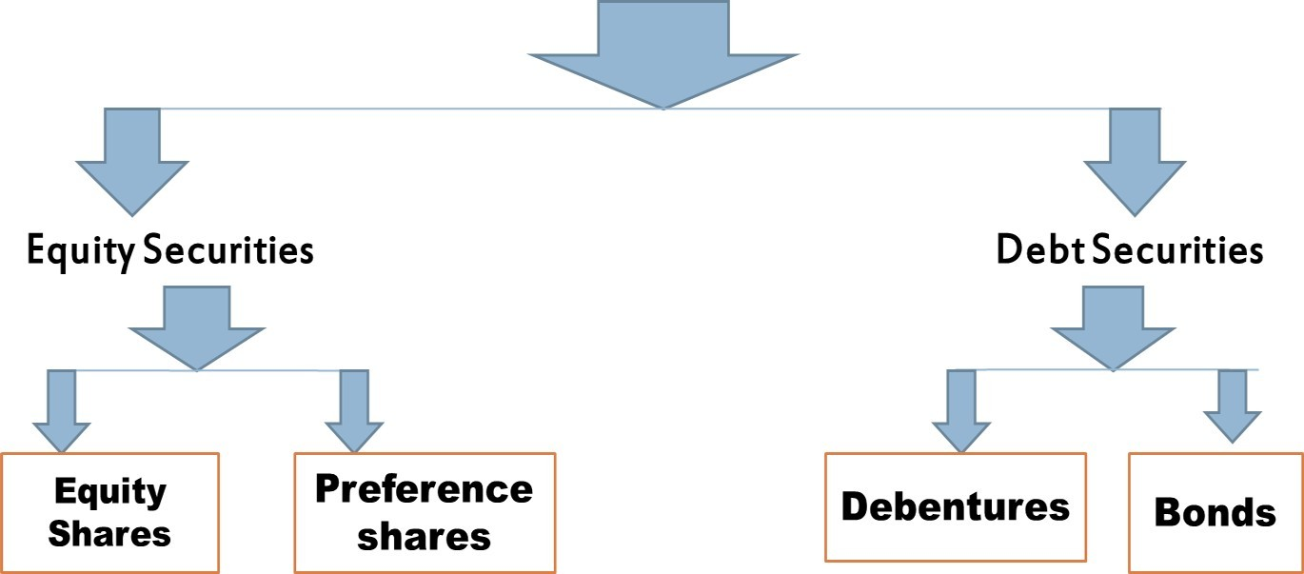
BASIC CAPITAL MARKET INSTRUMENTS

Slide 73
Capital market instruments
Long-Term Financial Instruments :
This sub-category comprises instruments with maturity longer than those of short- and medium term instruments. Some of the long-term instruments are as follows :
i) Equity Shares :
Equity shares are also termed as ordinary shares or common shares.
Holders of the equity shares are the owners of the company as they have invested in the company.
They have the voting rights and part of decision-making process on major issues relating to the affairs of the company.
The shareholders' return on the funds invested by them in the company is in the form of 'Dividend".

Slide 74





MERITS OF EQUITY SHARES
LIMITATIONS OF EQUITY SHARES
A permanent source of finance to the company
No fixed rate of dividend
Easy liquidity and marketability
No guarantee on returns to shareholders
Loss of managerial control

Slide 75
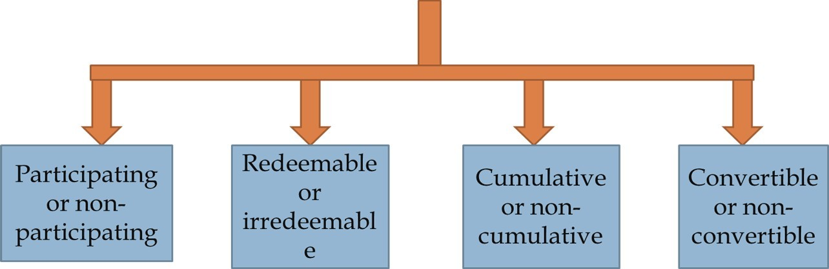
ii) Preference Shares :
Preference shares have the unique characteristics of being hybrid in nature, i.e., they have certain features of equity and at the same time certain features of debentures. It is similar to equity shares in the following ways :
From disposable profits, the dividend of preference shares is paid.
Preference dividend is not compulsory for the payment of fixed amount of dividend. It totally depends upon the director's decision.
There is no tax-deduction in Preference Dividend.

Slide 76


Slide 77
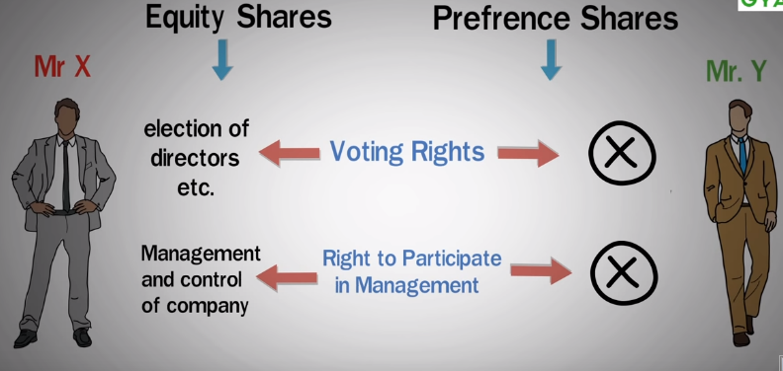

Slide 78


Slide 79
iii) Debentures :
A debenture is an instrument through which an Indian Public Limited Company can raise funds from the market.
A debenture is signed by the company with its seal, to acknowledge the debt of the person(s). ensuring the advanced amount of debt. So this is a security issued by a company against debt.
A company may issue debentures after getting Certificate of Commencement of Business, provided its Memorandum of Association contain a clause which permits the company to issue debentures.
Redeemable or irredeemable
Convertible or non- convertible
Secured or
unsecured
Bearer or
registered

Slide 80
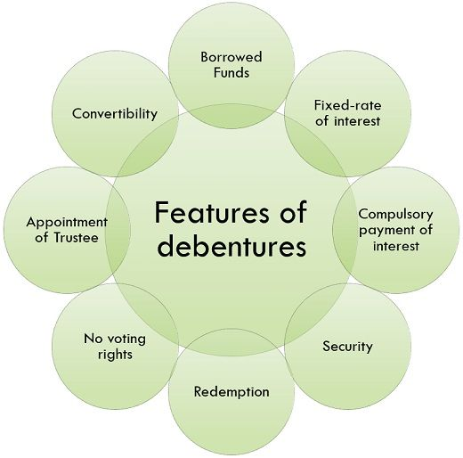

Slide 81
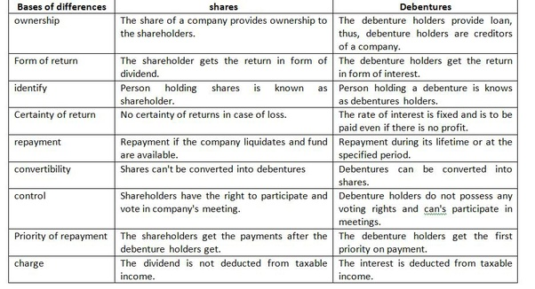

Slide 82
iv) Term Loan :
Term loans are loans procured for the acquisition of fixed assets and working capital margins and are repayable over a long period of time, generally ranging between one year and ten years.
Term loans are extended by banks and other financial institutions set up for the purpose of extending term finance.
Term loans differ from short-term bank loans, also known as 'Working Capital Finance', which are sanctioned by banks to meet day-to-day business requirements like purchase of raw material, work-in-progress and finished goods, etc. They are self liquidating over a period of time.

Slide 83
v) Bonds :
A bond is a fixed-income instrument that pays a fixed interest rate or coupon to the holders.
Bond prices are inversely correlated with interest rates: when rates go up, bond prices fall, and vice versa.
Bonds are sold with maturity dates, which are the dates by which the principal amount must be paid back in full or risk default.

Slide 84
TYPES OF BONDS
Bearer bonds
Registered bonds
Callable bonds
Convertible bonds
Zero coupon bonds
Fixed rate bonds

Slide 85
Bond | Debenture
A bond is a financial instrument showing the indebtedness of the issuing body towards its holders. | A debt instrument used to raise long term finance is known as Debentures.
Bonds are generally secured by collateral. | Can be Secured or Unsecured.
Low Interest Rates | High Interest Rates.
Issued by Govt Agencies, Financial institution, Corporation etc. | Issued by Public Companies
Accrued | Periodical payments

Slide 86
EQUITY SECURITY | DEBT SECURITY
Owner of the company. | Creditor of the company.
Get Dividend only when company earns sufficient profits. | Provides steady income to the investors.
Have voting rights. | No voting rights.
Not secured. | Secured in nature.
Share capital of the company. | Borrowed capital of the company.

Slide 87
Hybrid Instruments
Securities which are legally debt securities but that have some equity-like features. Debt characteristics of hybrid securities include deferred or scheduled interest payments.
Examples are convertible debentures, warrants etc.
A hybrid financial insturment is an investment that blends characteristics of both equity and debt markets (stocks and bonds).
The most common form of a hybrid instrument is the convertible bond, warrants.
This type of security is an issuance of debt that can be converted to a company's common stock at any given time. So, it is kind of like a call option.

Slide 88
Introduction to Personal Finance

Slide 89
Introduction to Personal Finance
Planning is important to ensure a direction for your day-to-day actions.
Creating a personal financial plan has six basic steps:
Determine your current financial situation.
Develop your financial goals.
Identify alternative courses of action.
Evaluate alternatives.
Create and implement your financial action plan.
Review and revise the financial plan
Personal Financial Planning in Action

Slide 90
1. Determine your current financial situation
The first step in creating your personal financial plan is determining your current financial situation.
Having a thorough understanding of your current financial situation will help you to formulate realistic and well-informed goals.
Assets (What I own)
Cash & Cash Equivalents
1, 2, 3……….
Personal Property
1, 2, 3……….
Invested Assets
1, 2, 3……….
Total of all Assets
Liabilities (What I Owe)
Current Bills
1. ……
2. ……
Outstanding Debt
1. …….
2. ……
Total of all Liabilities
 | Total Assets
 | Total Liabilities
 | Net Worth

Slide 91
2. Develop your financial goals
Goals should be SMART, that is specific, measurable, attainable, realistic, and time-based.
Also develop short-term, intermediate, and long-term goals. Developing each of these types of goals will allow you to achieve successes early in the plan while also keeping your eye toward the future.
Short-term or intermediate goals may also serve as stepping stones to reach long-term goals.
When developing your goals, be sure to differentiate between necessities and wants. Establish priorities
Using the worksheet on the next slide, add to, amend or re-record those goals for incorporation into your personal financial plan.

Slide 92
Financial Plan Goals Worksheet
Short-Term Goals (Less than 1 year)
Priority | Goal | Total Cost | Duration | Monthly cost | Target Date
Intermediate Goals (1-10 years)
Priority | Goal | Total Cost | Duration | Monthly cost | Target Date
Long-Term Goals (Over 10 years)
Priority | Goal | Total Cost | Duration | Monthly cost | Target Date

Slide 93
3. Identify alternative courses of action
You will have to devise strategies to help you bridge the gap from where you are today to where you would like to be.
Alternative courses of actions will fall into one of two categories:
Reallocating existing resources or Generating new ones.
Existing resources can be utilized by earmarking current savings or shifting current allocations as in the example above.
Generating new resources may require changing jobs to improve your wage outlook, taking on additional hours or investing your savings more aggressively to generate higher rates of return.

Slide 94
Goal Strategies Worksheet
Short-term Goal:
Target Date: | Monthly Cost:
Strategy 1:
Strategy 2:
Strategy 3:
Intermediate Goal:
Target Date: | Monthly Cost:
Strategy 1:
Strategy 2:
Strategy 3:
Long-term Goal:
Target Date: | Monthly Cost:
Strategy 1:
Strategy 2:
Strategy 3:

Slide 95
4. Evaluate alternatives
Once you have given serious thought to the options available that could lead you to your goals, you may begin to realize just how many options there are. So, which courses of action should you take to achieve your desired goals?
The answer is: that depends
Before you can select strategies to complete your financial plan, you’ll have to thoroughly evaluate and weigh your options.
When assessing your options consider the pros and cons of each option.

Slide 96
Goal:________________
Strategy 1:
Pros | Cons
Strategy 1:
Pros | Cons

Slide 97
5. Create and implement your financial action plan
Having identified options for reaching your goals and having weighed each strategy, it’s now easier to look at the cost of your goals in terms of your current situation.
This can help you to prioritize your goals as you consider how much it will cost you to implement each one.
Finalizing your plan will require you to make decisions as to which goals to pursue and the best courses of action to take.
Once you’ve gone through the effort of creating your plan, discipline is paramount.
Be conscious about establishing actionable steps you can take to lead you to success when creating your plan. Having concrete steps to take will help you ensure you are doing what you need to do to stay on track to accomplish your goals.

Slide 98
6. Review and Revise your Plan
One fact remains: life happens. For this reason, it is important to review your plan often and revise it as needed.
Reviewing your financial plan can help you to gauge your progress toward meeting your goals.
Your financial situation will change from time to time. You may incur unplanned expenses or receive unplanned incomes. These events may require you to change the path you will follow to reach your goal.
The fact is your life will change. Your financial plan will have to change too. Be faithful in reevaluating your plan from time to time to ensure your goals haven’t changed and that you are on pace to reach those goals.

Slide 99
Money Management Skills

Slide 100
Money Management Skills
Set Realistic Financial Goals
Create a Personal Budget
Limit Credit Card Expenses
Contribute to Savings
Be Consistent

Slide 101

1. Set Realistic Financial Goals
“knowing where you stand financially and create where you want to be in five, 10, or 25 years in the future”
People should prioritize simple wins:
Pay off credit card debt
Cut out unnecessary expenses
Avoid changes to your plan or goals
Understand your relationship to money

Slide 102

2. Create a Personal Budget
Having a budget is crucial to managing money effectively.
Budgets keep track of expenses, help keep people out of debt, and help people organize their financial priorities.
It is important to note that budgets can change over time. The first budget you create will not be the one you’ll have forever.

Slide 103

3. Limit Credit Card Expenses
A simple swipe can do more harm than good.
According to Wallet hub, the average American household has over $7,000 in credit card debt.
Psychology behind credit card spending. Since consumers aren’t spending “real” money, they’re more likely to make use of their plastic cards. The bill that comes at the end of the month is in the back of their minds.

Slide 104
4. Contribute to Savings
A goal for expert money managers is to grow wealth and stability through financial security.
Experts believe that savings accounts are the best place to start investing and managing money
A savings account is important because it is the backstop for your financial life.
Overall, consistent saving allows people to meet their money management goals.

Slide 105
5. Be Consistent
To put all of your money management skills to use, you must be consistent.
People who have successful saving habits stick to their goals and only change them when life events such as pay raises and career changes occur.
“A financial plan is simply a guide,” Hyde said. “You’re stating where you want to go.”
Without consistency, it is easy for money management beginners to fall back into old habits or make money mistakes.

Slide 106
Common Money Mistakes to Avoid
1. Delaying on a Financial Plan
Not having a financial plan leads to bigger financial risks. Without a financial plan, people are more likely to be unprepared for unexpected surprises.
2. Spending Mindlessly
Using shiny credit cards for every purchase can lead spenders down a dull path.
“As long as you have control of your spending daily, you’ll remain confident.”
3. Letting Payments Pile Up
If you let payments pile up, it only hurts in the long run. But the coronavirus pandemic has made it more difficult for people to stay on top of their payments.

Slide 107
Taxes in Your Financial Plan

Slide 108
Taxes in Your Financial Plan
Tax planning is the analysis of a financial situation or plan to ensure that all elements work together to allow you to pay the lowest taxes possible.
Proper tax planning makes it easier to build your personal finances and afford the things you want.
Taxation becomes relevant at various stages of your financial plan.
For example,
There is a tax rebate when you invest in select categories of investments.
There is also a tax implication when you earn regular returns in the form of interest or dividends.
There is a tax implication at the time the capital gains are realized on assets.
Lastly, there is the all important concept of EET(Exempt-Exempt-Taxable) that could change the economics of your financial plan.

Slide 109
Tax breaks at the time of investing
One of the basic principles of long term investing is that you must not focus overly on the tax aspect. But given a choice, you need to consider a more tax efficient option.
If you need to make an allocation of Rs.100,000 during the year to mutual funds, then should you do it in diversified equity funds or an ELSS(Equity Linked Savings Scheme). Remember, an ELSS is also an equity fund with a 3-year lock period and giving the additional benefit under Section 80C.
The 30% exemption in the year of investing substantially improves your yield on the fund.

Slide 110
Aspect | ELSS (Equity Linked Savings Scheme) | Diversified Equity Fund
Type of Fund | 🟩 Equity mutual fund with tax-saving benefits under Section 80C | 🟨 Equity mutual fund with no specific tax-saving benefits
Lock-in Period | 🟨 3 years | 🟩 No lock-in (can redeem anytime)
Tax Benefit on Investment | 🟩 Eligible for deduction under Section 80C (up to ₹1.5 lakh/year) | 🟨 No tax deduction
Investment Amount (Example) | ₹1,00,000 | ₹1,00,000
Tax Saving (30% slab) | 🟩 ₹30,000 in Year 1 | 🟨 ₹0
Assumed Growth Rate | 12% p.a. | 12% p.a.
Value After 3 Years | ₹1,40,500 | ₹1,40,500
Capital Gain | ₹40,500 | ₹40,500
LTCG Tax @ 10% | ₹4,050 | ₹4,050
Post-Tax Value from Fund | ₹1,36,450 | ₹1,36,450
Effective Total Value (incl. tax saved) | 🟩 ₹1,66,450 | ₹1,36,450
Effective Advantage | 🟩 Higher post-tax yield due to upfront tax saving | 🟨 Lower post-tax yield, no upfront saving
Best For | 🟩 Investors looking for tax efficiency & long-term equity exposure | 🟩 Investors seeking liquidity & equity growth without lock-in

Slide 111
Tax implications of regular income on investments
This is an important consideration when you have to choose between similar investment products.
Assume that you have an allocation of 20% to debt products during the year. You can invest in a bank FD but then the interest earned on the FD will be taxed at the peak rate of tax applicable to you. That will substantially reduce your post-tax returns.
On the contrary, if you invest the money in debt mutual funds and opt for a dividend plan, then the dividend earned by you will be entirely tax-free in your hands. You also get the added benefit of capital appreciation when the interest rates go down, further adding to your post-tax yields.

Slide 112
Aspect | Falling Interest Rates | Rising Interest Rates
Initial Investment | ₹10,00,000 | ₹10,00,000
Dividend Payout (6%) | ₹60,000 (tax-free in your hands) | ₹60,000 (tax-free in your hands)
Impact on Bond Prices / NAV | Bond prices rise → NAV increases | Bond prices fall → NAV decreases
Capital Appreciation / Loss | +3% NAV gain = ₹30,000 | −3% NAV loss = ₹30,000
Total Annual Post-Tax Return | ₹60,000 + ₹30,000 = ₹90,000 | ₹60,000 − ₹30,000 = ₹30,000
Post-Tax Yield (%) | 9% | 3%
Investor Benefit | Dividend + capital gains → higher returns | Dividend partly offset by capital loss → lower returns
Key Takeaway | Falling rates are favorable for debt funds | Rising rates reduce total returns

Slide 113
Tax exemption at the time of booking profits
This factor is very relevant when you are actually comparing equity versus debt.
The definition of capital gains is much more favourable in the case of equities as compared to debt.
For example, in case of equities and equity mutual funds, the definition of long term is determined by the holding period of 1 year. Additionally, STCG for equities is charged at a concessional rate of 20% while the LTCG on equities is 12.5%.
Alternatively, if you own a debt fund with a growth option then it will be long term only if it is held for 3 years. In this case, short term capital gains will be taxed at your peak rate while long term gains will be taxed at 20% after considering indexation (if the transfer is made on or before 22nd July 2024 after indexation benefit). For subsequent transfers, the tax rate shall be 12.5% without the indexation benefit.
A good option for you to consider will be the Balanced Fund plan since it combines the benefits of debt and equity.
Notes:
Equity funds and equity-oriented balanced funds enjoy more favorable tax treatment — short 1-year threshold for long-term status + lower tax rates.
Debt funds require a 3-year holding period for long-term benefits, and short-term gains are taxed heavily if you’re in a higher slab.
Balanced funds combine stability from debt with tax advantages of equity.

Slide 114
Feature | Equity Fund 🟢 | Debt Fund (Growth Option)🔴 | Balanced Fund (Equity-Oriented) 🟢
Initial Investment | ₹5,00,000 | ₹5,00,000 | ₹5,00,000
Value After 2 Years (10% p.a.) | ₹6,05,000 | ₹6,05,000 | ₹6,05,000
Capital Gain | ₹1,05,000 | ₹1,05,000 | ₹1,05,000
Holding Period Rule for LTCG | >1 year ✅ | >3 years ❌ (short term here) | >1 year ✅
Tax Rate on Gain | 10% on gain above ₹1 lakh 🟢 | Slab rate (30% assumed) 🔴 | 10% on gain above ₹1 lakh 🟢
Taxable Gain | ₹5,000 | ₹1,05,000 | ₹5,000
Tax Payable | ₹500 🟢 | ₹31,500 🔴 | ₹500 🟢
Post-Tax Amount | ₹6,04,500 🟢 | ₹5,73,500 🔴 | ₹6,04,500 🟢
Tax Efficiency | High 🟢 | Low 🔴 | High 🟢
Best For | Long-term wealth creation | Short-term, fixed-income allocation | Balanced risk & tax efficiency

Slide 115
Understanding EEE and EET when it comes to redemption
When you currently invest in an endowment life policy or in a provident fund, it is classified as EEE (Exempt, Exempt, and Exempt). That means, there is tax exemption at the time of investment, tax exemption on returns and also tax exemption on redemption.
This tends to distort the yield curve and hence the CBDT(The Central Board of Direct Taxes) has already initiated the plan to shift to EET, meaning that in the year of redemption it will be treated as income in the hands of the investor.
If the complete shift to EET happens, it could make a huge difference to your post-tax returns.

Slide 116
Impact of Shift from EEE → EET
Particulars | EEE 🟢 | EET 🔴 (30% slab)
Initial Investment | ₹1,00,000 | ₹1,00,000
Maturity Value (10 yrs @ 7%) | ₹1,96,715 | ₹1,96,715
Tax on Withdrawal | ₹0 | ₹59,015
Post-Tax Value | ₹1,96,715 🟢 | ₹1,37,700 🔴
Tax Efficiency | High 🟢 | Low 🔴
Under EEE, your money compounds without any erosion from tax at any stage. Under EET, even though your investment grows tax-free during the holding period, a large chunk is taken away at maturity — especially painful if you’re in a higher tax bracket.

Slide 117
Difference between tax planning and financial planning based upon some important parameters.
PARAMETERS | TAX PLANNING | FINANCIAL PLANNING
Objective | Tax planning is aimed at reducing your tax liability by helping you avail tax benefits allowed under the relevant sections of the Income Tax Act, 1963. As an efficient tax planner, you should always be keen on reducing your tax burden in the short-term. Planning your taxes beyond the current year can often be a redundant exercise as the Indian Government announces a new budget each year. | The primary objective of financial planning is to help you create and manage wealth in order to eventually meet your financial goals in the long run. An efficient financial planner should look ahead and plan for short-term as well as long-term financial goals.

Slide 118
PARAMETERS | TAX PLANNING | FINANCIAL PLANNING
Scope | The scope of tax planning is solely limited to helping you receive the maximum possible tax benefits each successive year. So, even if you employ the services of a professional tax planner, all they can help you with is filing efficient tax returns and helping you invest in tax-free avenues. | In contrast, financial planning involves a more holistic approach to managing your wealth. It often covers various aspects such as cash flow management, asset management, insurance, investments, retirement planning, and even tax planning.

Slide 119
PARAMETERS | TAX PLANNING | FINANCIAL PLANNING
Benefits | Apart from increasing your overall tax efficiency, efficient tax planning can also enable you to budget and manage your taxes at the beginning of each fiscal year instead of scrambling to file optimum tax returns at the eleventh hour. | Financial planning helps increase your savings by planning and tracking your expenditures. It can also facilitate an overall better standard of living by helping you utilize your money in the best manner possible. By planning your finances well in advance, you can create an emergency fund to take you through any unforeseen financial obstacles in the future. In this way, financial planning can also help you attain some peace of mind knowing that your finances are secure at all times.

Slide 120
Consumer Credit

Slide 121
Consumer Credit
Consumer credit provides access to more spending power, which enables you to do things like take out a home loan or make purchases with a credit card.
Responsible use of consumer credit can open doors to new opportunities, but borrowing also has the potential to result in unmanageable levels of debt.
Types of Consumer Credit
1. Instalment Credit
2. Revolving Credit

Slide 122
1. Instalment Credit: typically refers to loans, such as mortgages, auto loans, personal loans and student loans. With instalment credit, you repay what you borrow in fixed payments made each month over a set period of time, or term. The monthly payments, or instalments, are based on the amount you borrow plus the interest you owe
2. Revolving Credit: is a flexible type of loan with a preset credit limit that allows you to borrow, repay, and borrow again as needed, unlike installment loans which have fixed repayment schedules. Here you only pay interest on the amount you borrow and your available credit replenishes as you make payments. It's a versatile tool for managing short-term expenses, building credit, and maintaining cash flow, though high interest rates and potential for debt accumulation are significant drawbacks if not managed wisely.
The most familiar and common type of revolving credit is a credit card.
Notes:
The amount of your monthly payment will depend on how much money you've borrowed and whether you regularly pay off the full balance to avoid interest changes. If you don't pay off your debt immediately, it rolls over—or "revolves"—to the next billing period.

Slide 123

Feature | Instalment Credit | Revolving Credit
Definition | You borrow a fixed amount once and repay it in equal monthly instalments over a set time. | You have a credit limit and can borrow repeatedly as long as you stay within that limit.
Examples | Home loan, car loan, personal loan, student loan. | Credit cards, personal/business lines of credit.
Repayment | Fixed monthly payments (principal + interest) until loan is fully paid. | Flexible monthly payments — minimum payment required but can pay more.
Term | Has a fixed end date (e.g., 5 years, 10 years). | No fixed end date — account stays open until you close it.
Interest Charges | Charged on the remaining loan balance. | Charged on any unpaid balance carried over to the next month.
Borrowing Again | You must apply for a new loan to borrow more. | Can borrow again immediately as long as you have available credit.
In short:
Instalment credit is like taking a taxi for a single trip — fixed route, fixed fare.
Revolving credit is like renting a car — you can use it as much as you like within limits, but costs depend on how long and how much you use it.

Slide 124
Advantages of Consumer Credit
Building your credit history: If you establish a solid payment history for consumer credit accounts, including credit cards and personal loans, and otherwise handle credit responsibly, consumer credit can be a valuable tool for building your credit.
Boosting your credit score: A positive history of making payments on credit cards, loans and other types of consumer credit can positively affect your credit score.
Providing perks and rewards: Consumer credit, particularly credit cards, can deliver goodies like airline miles, hotel points and cash back rewards.
Protecting you against fraud: Credit cards provide all sorts of ways to protect yourself against fraud, such as contactless cards, virtual card numbers, card-locking capabilities and little to no cardholder liability for unauthorized purchases.
Reimbursing certain purchases: Some credit card issuers reimburse you for purchases if you're not satisfied with an item you bought but the merchant won't accept a return.

Slide 125
Disadvantages of Consumer Credit
Consumer credit can come at a cost, including interest charges and potential fees.
Access to consumer credit might enable you to spend beyond your means.
Missed payments and high debt levels could damage your credit and impact your ability to obtain credit in the future.
Piling up a lot of consumer debt could result in your debt being turned over to a debt collector, who might constantly nag you about paying the debt.
Some predatory lenders might trap you into borrowing money at sky-high interest rates.

Slide 126
Savings and Payment Services
Savings Services
Savings services are financial products offered by banks, credit unions, post offices, and other institutions that allow individuals or organizations to store money securely while earning interest.
Payment Services
Payment services are facilities that enable the transfer of funds from one person/entity to another, physically or electronically.

Slide 127
Aspect | Savings Services | Payment Services
Meaning | Facilities to store money securely, often earning interest. | Facilities to transfer money from one person/entity to another.
Purpose | Encourage savings, safety of funds, and interest earnings. | Enable quick, secure, and convenient transactions.
Advantages | Safe storage of money, Earn interest, Easy withdrawal, Encourages saving habits, Clear records | Convenient and fast, Secure alternative to cash, Instant transfers, Digital proof of payment, Global accessibility
Disadvantages | Low interest rates, Withdrawal limits, Minimum balance requirements, Opportunity cost | Transaction fees, Technical/network issues, Fraud risks, Requires internet/mobile access
Sources | Commercial banks, Post office schemes, Credit unions/cooperatives, Microfinance institutions, Fintech savings platforms | Bank transfers (NEFT, RTGS, IMPS), Debit/credit cards, Mobile wallets (Paytm, Google Pay), UPI, Cheques & demand drafts, POS machines
Cost | Account maintenance fees, Minimum balance penalties, Withdrawal/service charges, Loss of interest on premature withdrawal | Transaction fees, Card annual fees, Merchant service charges, Currency conversion charges

